Slide 1
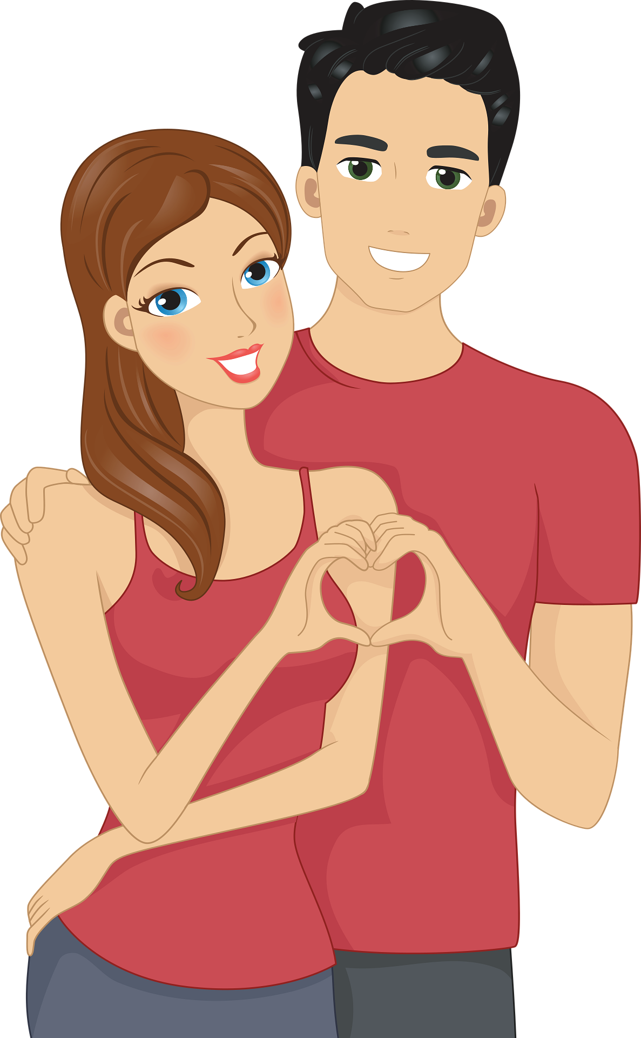
Introduction to the Dating App Project
Unveiling the Future of Dating Apps

Slide 2
Need of Dating :-
Involves respectful and considerate behavior towards one another. It emphasizes mutual respect, clear communication, and genuine interest in getting to know each other.
It prioritizes building a strong emotional bond and understanding between partners, with the intention of potentially forming a long-term, committed relationship based on shared values and compatibility.
It provides an opportunity for personal growth, social interaction, and the pursuit of companionship in a respectful and considerate manner.

Slide 3

Developing the App: Flutter
Key Technologies for User-Centric Dating App
Flutter is an open-source UI software development kit created by Google. It is used to develop natively compiled applications for mobile, web, and desktop from a single codebase.

Slide 4
Why flutter ?
Enables cross-platform development, allowing code to run seamlessly across iOS, Android, web, and desktop platforms, ensuring consistency and efficiency.
Hot Reload feature allows developers to iterate quickly, instantly visualizing changes without losing app state.
simplifies the integration of existing codebases, making incremental adoption within projects straightforward.

Slide 5
Widgets used in the Project :-
MaterialApp: The root widget of the Flutter app.
Scaffold: A top-level container for a MaterialApp that provides a basic material design visual layout structure.
Container: A widget that combines common painting, positioning, and sizing configuration.
DecorationImage: A widget that paints an image.
Center: A widget that centers its child both horizontally and vertically.
Padding: A widget that insets its child by the given padding.
Column: A widget that displays its children in a vertical array.
TextFormField: A form field that allows the user to enter text.
SizedBox: A widget that takes up a given amount of space on the main axis.
ElevatedButton: A button with an elevation that can be used to create a Material Design elevated button.
AppBar: A material design app bar that can be used as the top-most widget in the Scaffold.
ListView: A widget that displays its children in a scrollable list.
ListTile: A single fixed-height row that typically contains some text as well as a leading or trailing icon.
CircleAvatar: A circular avatar that can be used to display a user's profile picture.
Row: A widget that displays its children in a horizontal array.
Text: A widget that displays a given text.
TextField: A widget that allows the user to enter text.
InputBorder: A border that can be used to decorate a TextField.

Slide 6
Features of the Project :-
Login Page: A user can enter their name, age, and gender, and then log in to the app.
Home Page: After logging in, the user is taken to the home page, where they can navigate to different sections of the app, such as:
My Profile: Displays the user's profile information (name, age, and gender).
View Profile: Displays a list of other users' profiles, with options to show interest or not.
Messages: Displays a messages of the users from other users.
Feedback: Allows the user to enter feedback, which can be saved to a database or sent to a server.
The app uses a romantic theme, with gentle background colors and images.

Slide 7
Conclusion :-
In conclusion, the Flutter Project is a basic implementation of a dating app that allows users to log in, view their profile, browse other profiles, send messages, and provide feedback. The code is well-structured and easy to follow, with each feature separated into its own widget class. The widgets and layouts provides a visually appealing and user-friendly interface.

Slide 8
Submitted By
Guhan(TL)
Benedict Ratzinger
Ajay kumar
Haribaskar

